Slide 1
Support Vector Machines

Slide 2
What We’ll Cover
How SVMs work
When to use them
SVM Kernels

Slide 3
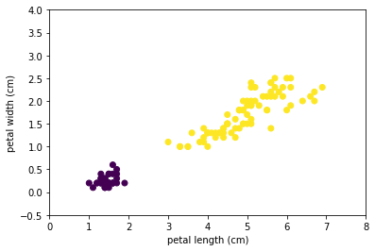
How SVMs work
Look for best hyperplane separation
Notes:
Photo: https://www.flickr.com/photos/107442568@N08/12547327134

Slide 4
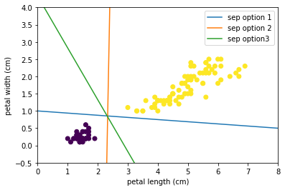
How SVMs work
Look for best hyperplane separation
Notes:
Photo: https://www.flickr.com/photos/107442568@N08/12547327134

Slide 5
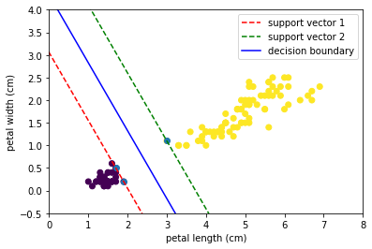
How SVMs work
Look for best hyperplane separation
Find the widest possible street between the datasets
Point(s) closest to the decision boundary define the support vectors
Notes:
Photo: https://www.flickr.com/photos/107442568@N08/12547327134

Slide 6
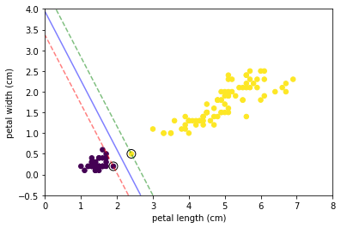
How SVMs work
Hard Margins
Keep data “off the streets”
Sensitive to outliers
Only works if data is fully separable
Notes:
Photo: https://www.flickr.com/photos/107442568@N08/12547327134

Slide 7
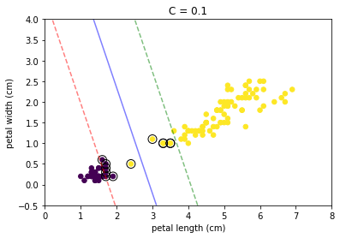
How SVMs work
Soft Margins
Data is allowed on the street
Balance street width vs margin violations
Likely generalizes better because it’s less strict
Margin determined by C parameter
Higher C -> strictier margins
Notes:
Photo: https://www.flickr.com/photos/107442568@N08/12547327134

Slide 8
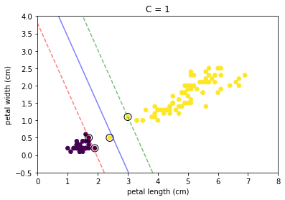
How SVMs work
Soft Margins
Data is allowed on the street
Balance street width vs margin violations
Likely generalizes better because it’s less strict
Margin determined by C parameter
Higher C -> strictier margins
Notes:
Photo: https://www.flickr.com/photos/107442568@N08/12547327134

Slide 9

How SVMs work
Soft Margins
Data is allowed on the street
Balance street width vs margin violations
Likely generalizes better because it’s less strict
Margin determined by C parameter
Higher C -> strictier margins
Notes:
Photo: https://www.flickr.com/photos/107442568@N08/12547327134

Slide 10
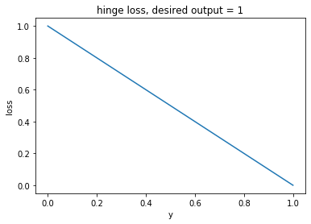

How SVMs work
Hinge Loss
Prediction w is the weights b is the bias term
Notes:
Photo: https://www.flickr.com/photos/107442568@N08/12547327134

Slide 11
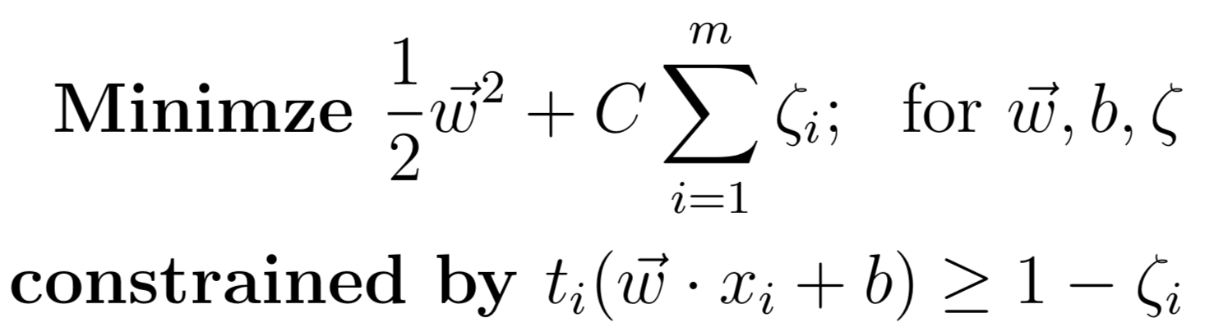
How SVMs work
Optimization
Zeta ( ) controls amount of margin violations (smaller -> less violations)
Weight term controls size of the street (smaller -> larger street)
C controls trade-off between the two objectives
Notes:
Photo: https://www.flickr.com/photos/107442568@N08/12547327134

Slide 12
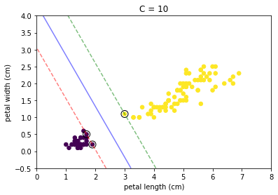
When to use SVMs
Small-medium sized datasets
Hyperplane separable features
Sensitive to feature scales
Notes:
Photo: https://www.flickr.com/photos/107442568@N08/12547327134

Slide 13
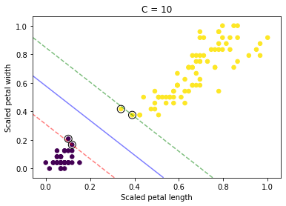
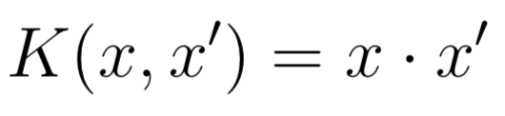
SVM Kernels
Linear
C parameter Through the kernel we mimic performing transformations on our features
Notes:
Photo: https://www.flickr.com/photos/107442568@N08/12547327134

Slide 14
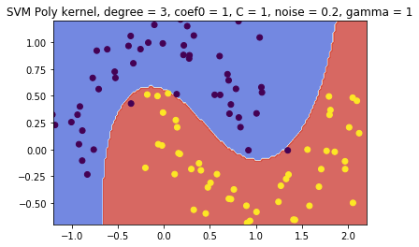
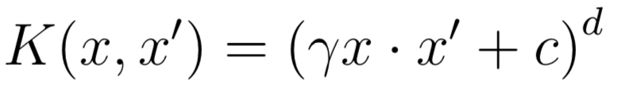
SVM Kernels
Linear
Polynomial (mimic poly features)
C - like before gamma - controls shape coef0 (c) - trade-off between high and low polynomial orders degree (d) - can affect overfitting
Poly. relations between features
Notes:
Photo: https://www.flickr.com/photos/107442568@N08/12547327134

Slide 15

SVM Kernels
Linear
Polynomial (mimic poly features)
C - like before gamma - controls shape coef0 (c) - trade-off between high and low polynomial orders degree (d) - can affect overfitting
Poly. relations between features
Notes:
Photo: https://www.flickr.com/photos/107442568@N08/12547327134

Slide 16
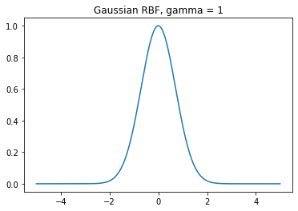

SVM Kernels
Linear
Polynomial
Radial Basis Function (RBF)
gamma - controls width
RBF relation between features
Notes:
Photo: https://www.flickr.com/photos/107442568@N08/12547327134

Slide 17
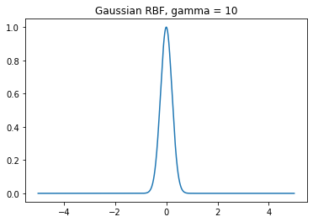
SVM Kernels
Linear
Polynomial
Radial Basis Function (RBF)
gamma - controls width
RBF relation between features
Notes:
Photo: https://www.flickr.com/photos/107442568@N08/12547327134

Slide 18
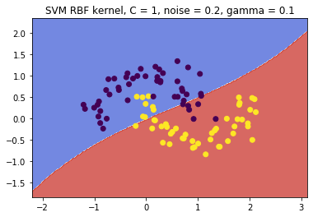
SVM Kernels
Linear
Polynomial
Radial Basis Function (RBF)
gamma - controls width
C - regularization (smaller = more)
RBF relation between features
Notes:
Photo: https://www.flickr.com/photos/107442568@N08/12547327134

Slide 19
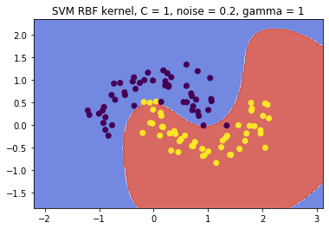
SVM Kernels
Linear
Polynomial
Radial Basis Function (RBF)
gamma - controls width
C - regularization (smaller = more)
RBF relation between features
Notes:
Photo: https://www.flickr.com/photos/107442568@N08/12547327134

Slide 20
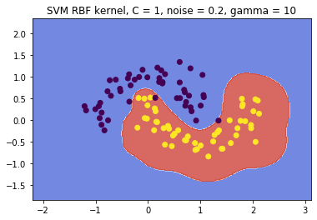
SVM Kernels
Linear
Polynomial
Radial Basis Function (RBF)
gamma - controls width
C - regularization (smaller = more)
RBF relation between features
Notes:
Photo: https://www.flickr.com/photos/107442568@N08/12547327134

Slide 21
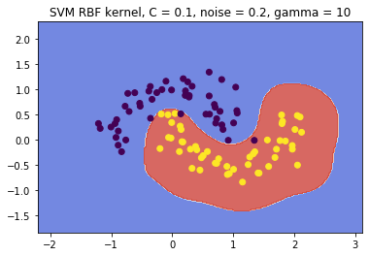
SVM Kernels
Linear
Polynomial
Radial Basis Function (RBF)
gamma - controls width
C - regularization (smaller = more)
RBF relation between features
Notes:
Photo: https://www.flickr.com/photos/107442568@N08/12547327134

Slide 22
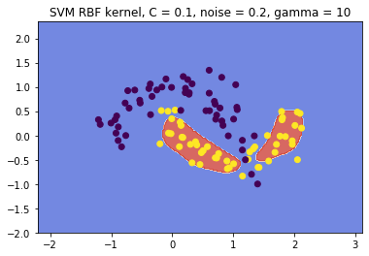
SVM Kernels
Linear
Polynomial
Radial Basis Function (RBF)
gamma - controls width
C - regularization (smaller = more)
RBF relation between features
Notes:
Photo: https://www.flickr.com/photos/107442568@N08/12547327134

Slide 23
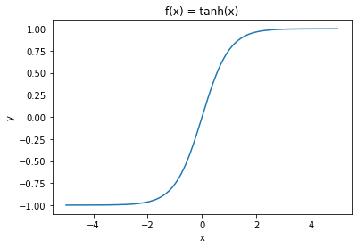
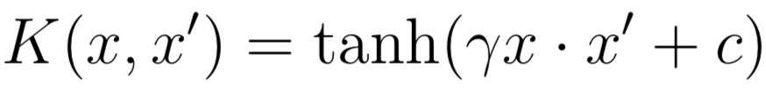
SVM Kernels
Linear
Polynomial
Radial Basis Function (RBF)
Sigmoid
gamme
coef0
C

Slide 24
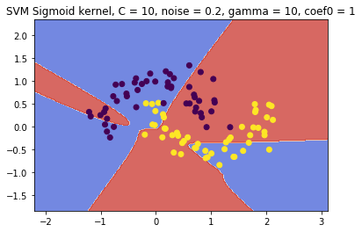
SVM Kernels
Linear
Polynomial
Radial Basis Function (RBF)
Sigmoid
gamma
coef0
C
Notes:
Photo: https://www.flickr.com/photos/107442568@N08/12547327134

Slide 25
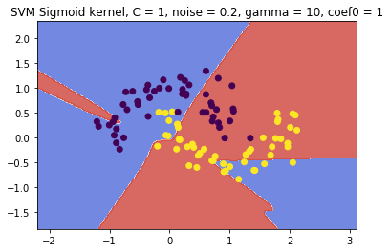
SVM Kernels
Linear
Polynomial
Radial Basis Function (RBF)
Sigmoid
gamma
coef0
C
Notes:
Photo: https://www.flickr.com/photos/107442568@N08/12547327134

